Slide 1




Merck Animal Health Forecasting Project Week 14 Updates
Team: Abhishek Dixit, Benjamin Elbaz,
Anqi Huang, Shuang Wei
Advisor: Kris Iyer
Date: APR 22nd, 2016

Slide 2
Agenda
1 – One Model for all NOBIVAC Skus
2 – Modeling Sales In & Sales Out of Activyl
Analysis of Cumulative Net Sales In & Sales Out from 2013-2015
Clustering Skus & Modeling Approach
Sales In & Sales out Results

Slide 3
Clustering among NOBIVAC SKUs
Sales IN:
Performed a K-Means Clustering on the scaled quantities to find clusters
K-Means:
Found 5 clusters based on Sales In: 1: 3 SKUs 2: 4 SKUs 3: 6 SKUs 4: 13 SKUs 5: 5 SKUs

Slide 4
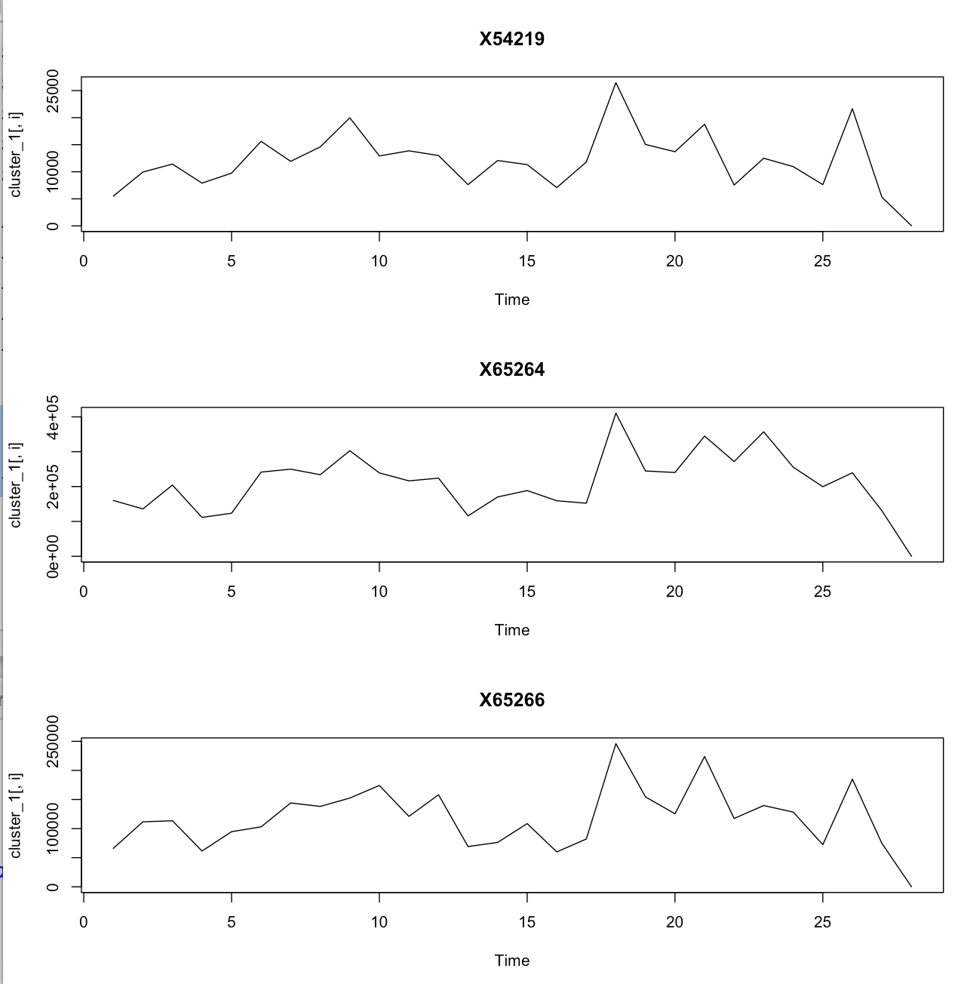
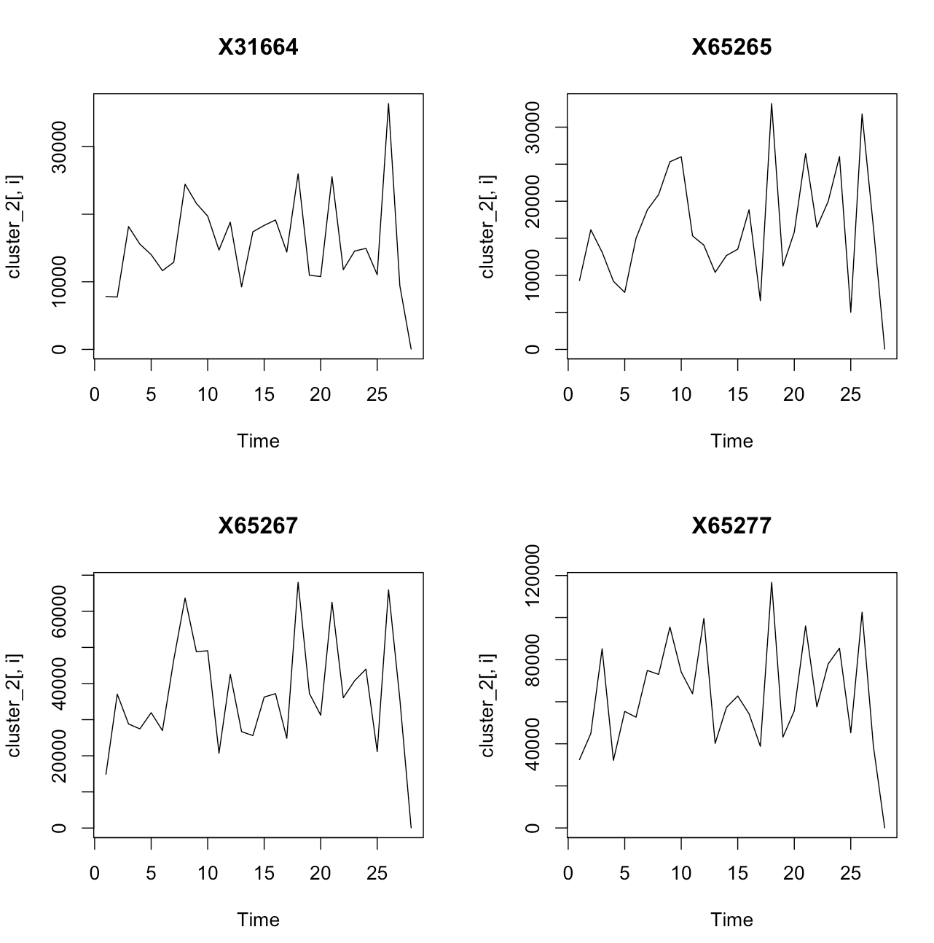
Clustering among NOBIVAC SKUs
Sales IN SKUs by clusters:
CLUSTER 1
CLUSTER 2

Slide 5
Clustering among NOBIVAC SKUs
Next, we converted in doses and aggregated them by clusters
Designed a model for each cluster
Average error: 25%
Next clustering method: use the correlation matrix

Slide 6
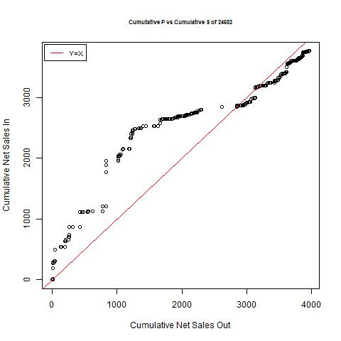
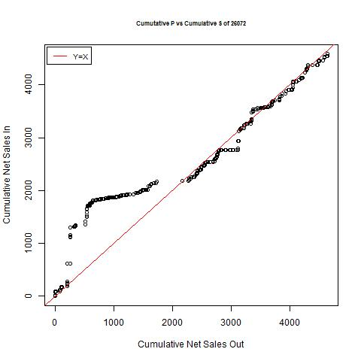
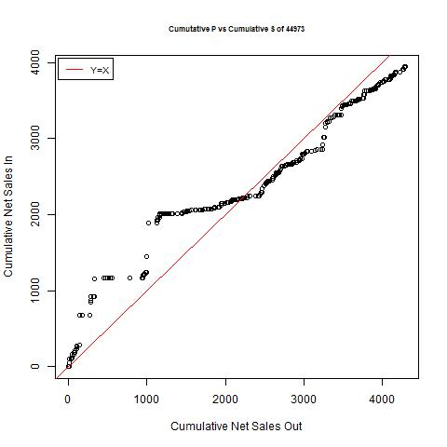
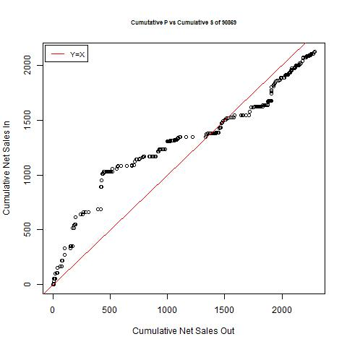
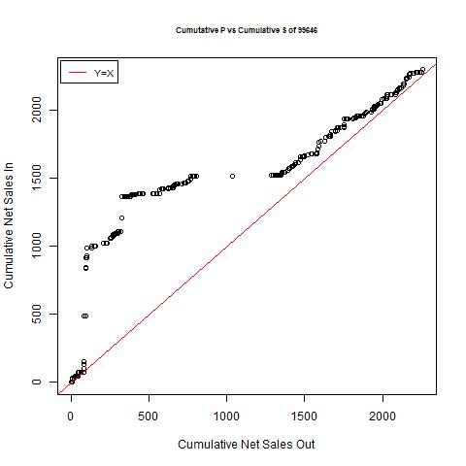
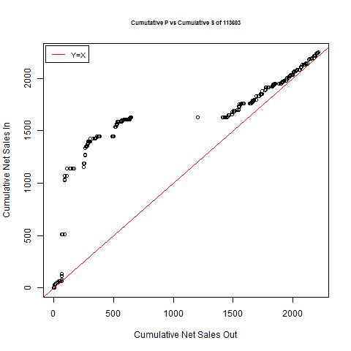
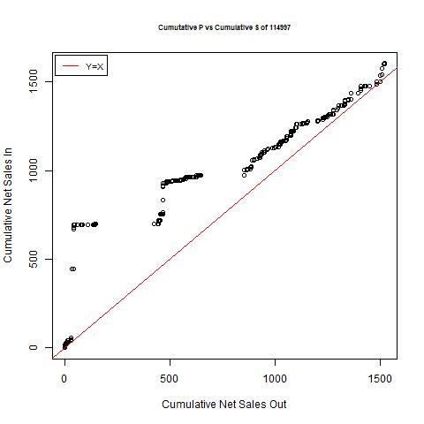
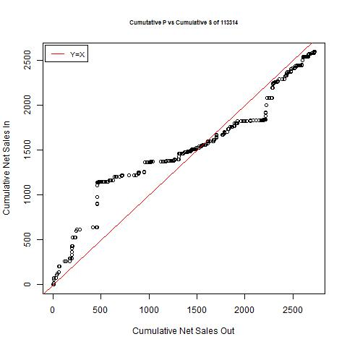
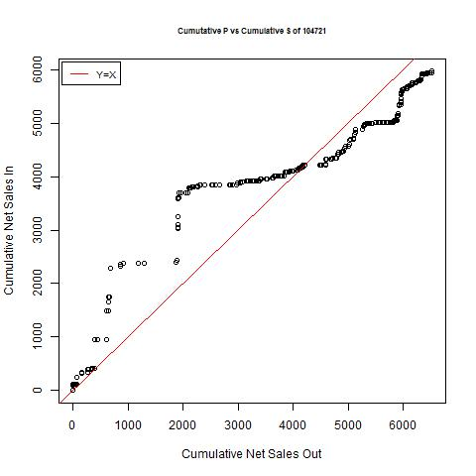
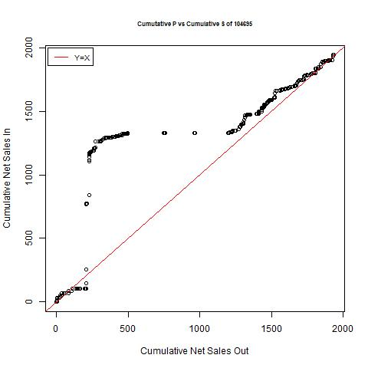
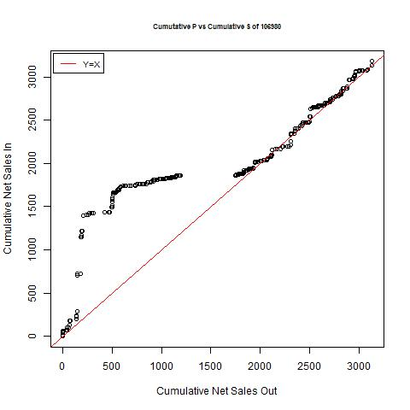
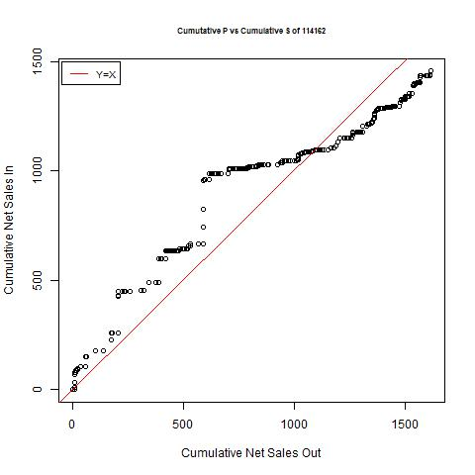
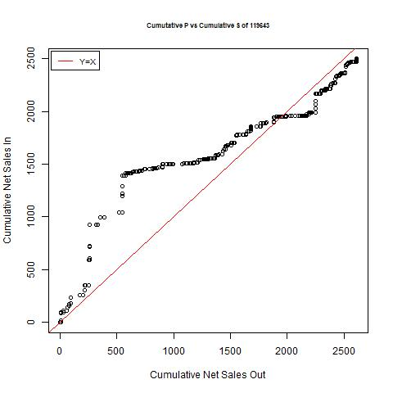
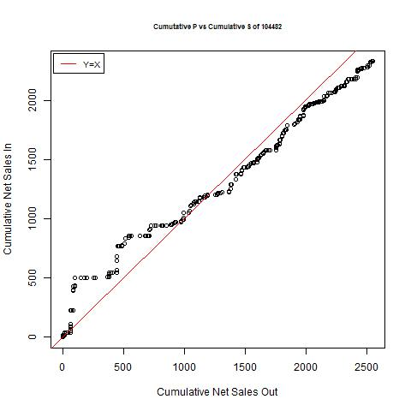
1 - Analysis of Cumulative Net Sales In & Sales Out from 2013-2015

Slide 7
Clustering & Modeling
Cluster Activyl skus based on the time when the supply and demand start to match
5 Clusters
Cluster 1: "104482","112173","107502","116338","115627","44973","111632","104721","108760","117105","113314","113408“ (From 2014 Feb)
Cluster 2: "115236","106980","26072","24682","90869","114162" (From 2014 Apr)
Cluster 3: "118926","104695","119643“ (From 2014 Jul)
Cluster 4: "113603","99646“ (From 2014 Sep)
Cluster 5: "114997" (From 2015 Apr)
Approach: Forecast Net Sales In & Net Sales Out and use them as predictors for Actual Sales In and Sales Out

Slide 8
Activyl Sales Out Result
Average Sales Out prediction error rate(8/2015-11/2015) for Cluster 1 is 25.20%
Average Sales Out prediction error rate(8/2015-11/2015) for Cluster 2 is 14.24%

Slide 9
Activyl Sales In Result
Average Sales In prediction error rate(8/2015-11/2015) for Cluster 1 is 51.11%.
Average Sales In prediction error rate(8/2015-11/2015) for Cluster 2 is 45.82%.

